Slide 1
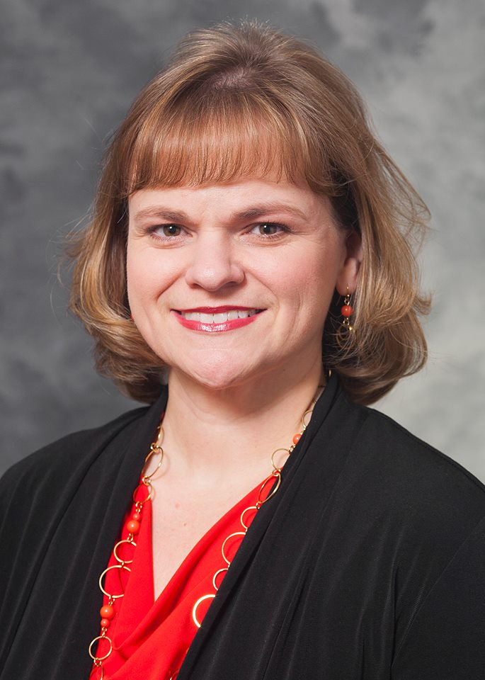
DEPARTMENT OF SURGERY GRAND ROUNDS
Wednesday, March 20, 2019
Presents
“Re-defining Success in Academic Surgery” Rebecca Sippel, MD, FACS
Dr. Sippel serves as Vice Chair of Academic Affairs and Professional Development, Chief of the Division of Endocrine Surgery and Program Director of the Endocrine Surgery fellowship in the Department of Surgery at the University of Wisconsin School of Medicine in Madison, WI. She is a graduate of Washington University School of Medicine in St. Louis, MO and completed surgery residency training at the University of Wisconsin Hospital and Clinics followed by an Endocrine Surgery fellowship at University of California-San Francisco Medical Center. She has served in leadership roles in multiple societies, including as President of the Association for Academic Surgery. She serves on several editorial boards including the Annals of Surgical Oncology and the Journal of Surgical Research. Dr. Sippel has published over 200 peer-reviewed manuscripts and multiple book chapters. She is an R01 funded researcher and a member of multiple academic and surgical societies.
Time: 7:00 am – 8:00 am
Location: Tobin Hall, SSOM 190

